Slide 1
Data Analytic Life Cycle
- Ashray Shetty

Slide 2
Extra information:
Rain forecast = 90%
VS
Stats:
Ranking = 5
Win % = 70
Draw % = 10
Loss % = 20
Weather conditions:
Rainy day win % = 10
Stats:
Ranking = 10
Win % = 55
Draw % = 15
Loss % = 30
Weather conditions:
Rainy day win % = 70

Slide 3
Customer Information
Product choice
design
Predict if customers
like the product

Slide 4
Data must pass through several steps before it can reveal insights
Data Analyst: They take data and use it to help companies make better business decisions
Data Analytic Life Cycle
Data
Insight

Slide 5
Who is more likely to ask these questions?
Do you have a transplant?
Do you have a alibi?
How long did the fever last?
Do you have allergies?
Where were you between 5 and 7 last night?
Can you identify this person?
I’d like to keep you here overnight for observation
Say Aaaa..

Slide 6
I. Data Collection
Ask the right questions
Collect the right data for your business
Use your experience to ask the right questions

Slide 7
Can you trust your data?
In 2016 election all polls indicate that more voters prefer Clinton to Trump.
The result is opposite. Why? What happened?
Many people did not want to say that they support Trump, especially after the Access Hollywood tape was released.

Slide 8

Bridging the gap
Gathered Data
Analysis

Slide 9
II. Data Preparation
data may have
Duplicate records
missing data
False information
typo

Slide 10
II. Data preparation
Why do we need to prepare the data?
Sometimes the data may have
Duplicate records
Incomplete or missing data
False information
typo
What happens when the data can not be trusted?
Can the decision be trusted? Decision making is jeopardized
Better chance to discover useful knowledge when data is clean

Slide 11
III. Data Analysis:

Slide 12
III. Data Analysis: Explore the data to find some interesting patterns
Can you guess the next steps?

Slide 13
III. Data Analysis: Explore the data to find some interesting patterns

Slide 14
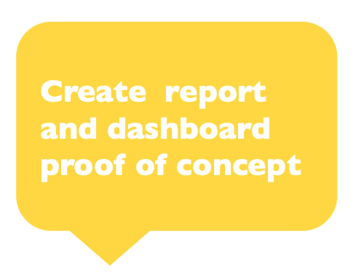
IV. Communicate results

Slide 15
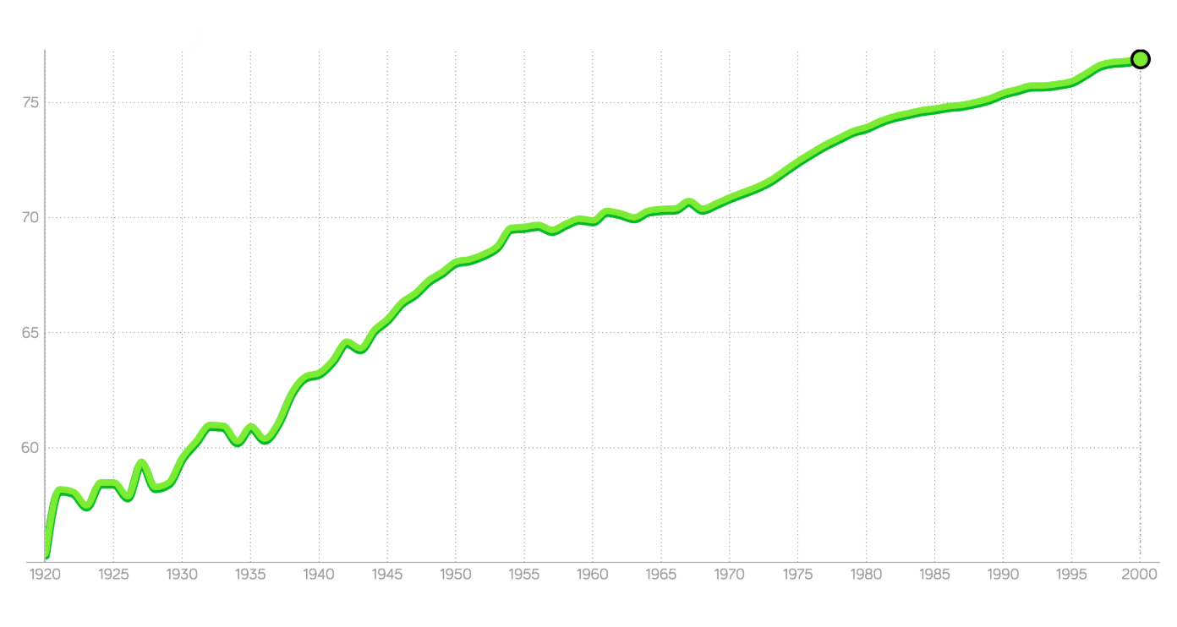
Test yourself!
What is an example of insight turned into action?
Marketing a new product based on past sales information
Prediction of customers' choices
Understanding of customer profiles
True or false:
Data Analytics can generate prediction from any data
Which of the following is not part of data analytic life cycle?
Collaborate
Collect
Prepare
Analyze
Which should you do first after you finish collecting your data?
Analyze and explore the data
Make sure data is clean
Extension:
What graph is best to show values in your data change over time?
What pattern does the graph below reveal?

Slide 16
Questions??

